Slide 1
Idea/Approach Details
Ministry/ Organization name: CHENNAI DISTRICT SMALL SCALE
INDUSTRIES ASSOCIATION (CDISSIA)
Problem Statement: SOFTWARE DEVELOPMENT FOR GST
Team Name: HACK4SOLUTION
Team Leader Name: ARYAN SINGH
College Code: 161

Slide 2
Solution:
Developing an app to ease the life of business owners. They can easily find details about GST laws, various forms and Calculate GST, Verify their GST registration and other things
App interface is easy to use very clean, user friendly method which includes minimal cost for usage and training

Slide 3
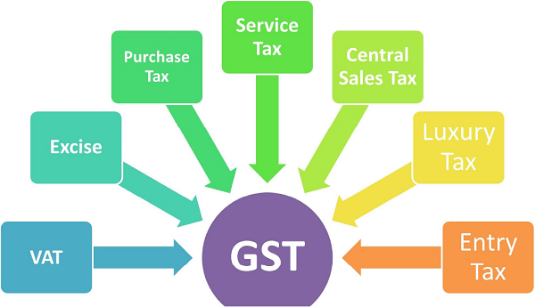
GST CHART

Slide 4
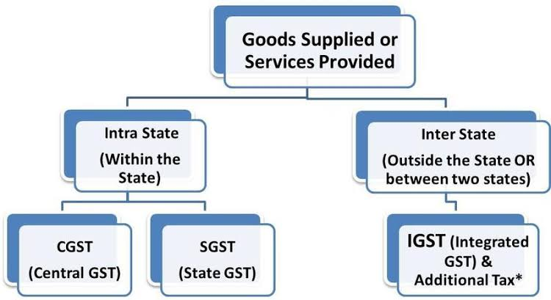
TYPES OF GST:

Slide 5
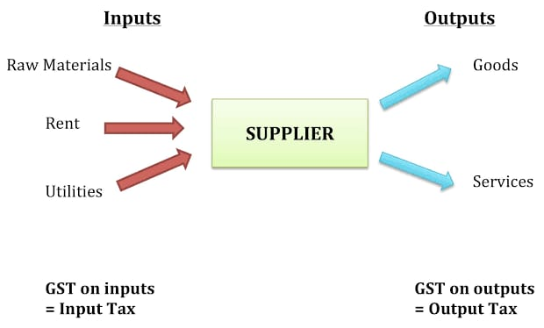
TAX FLOW:

Slide 6
Technology stack:
Language used:Python
Dependencies
USER DEPENDENT
COST
INFORMATION FLOW
Show Stopper
TIME SAVING
USER FRIENDLY
SMART COMMUNICATION
SIMPLE INTERFACE

Slide 7
Application working chart
(just for reference,not included in the flowchart)
Database
Login:-@example
Password:####
Register/Login
Verification
Options
User
Home
Administrator
Purchase TAX
Central TAX
Calculator+GST
LAWS/Rules
Logout
Delete

